Slide 1
UniPath Github Repository
Team - 3
CS691
Team-3
CS691

Slide 2
The link to our github repository:
https://github.com/Shazia6/UniPath.git
Anyone with this link can gain access to our project on Github, the repository is public.

Slide 3
Installation Steps:
1.Go to IntelliJ -> File -> New -> Project from Version Control
Enter the URL -> Clone
2.Click IntelliJ IDEA -> Maven
Change “User settings file” “Local repository”
3.Go to Application.yml -> change “username” “password”
4.Click File -> Project Structure -> Project -> Choose SDK 1.8

Slide 4
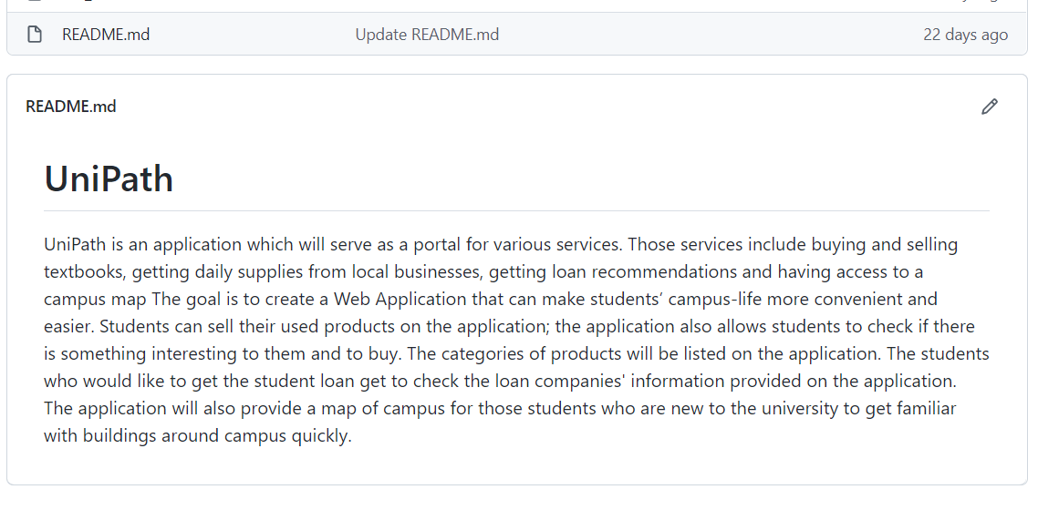
Description of our Project:

Slide 5
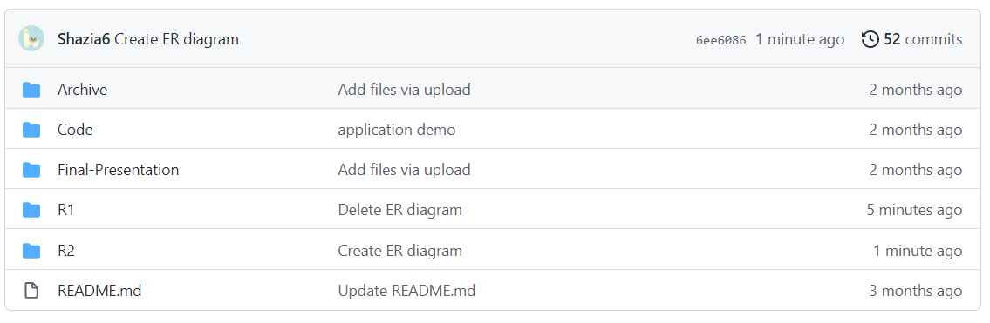
Overview of our Repository:

Slide 6
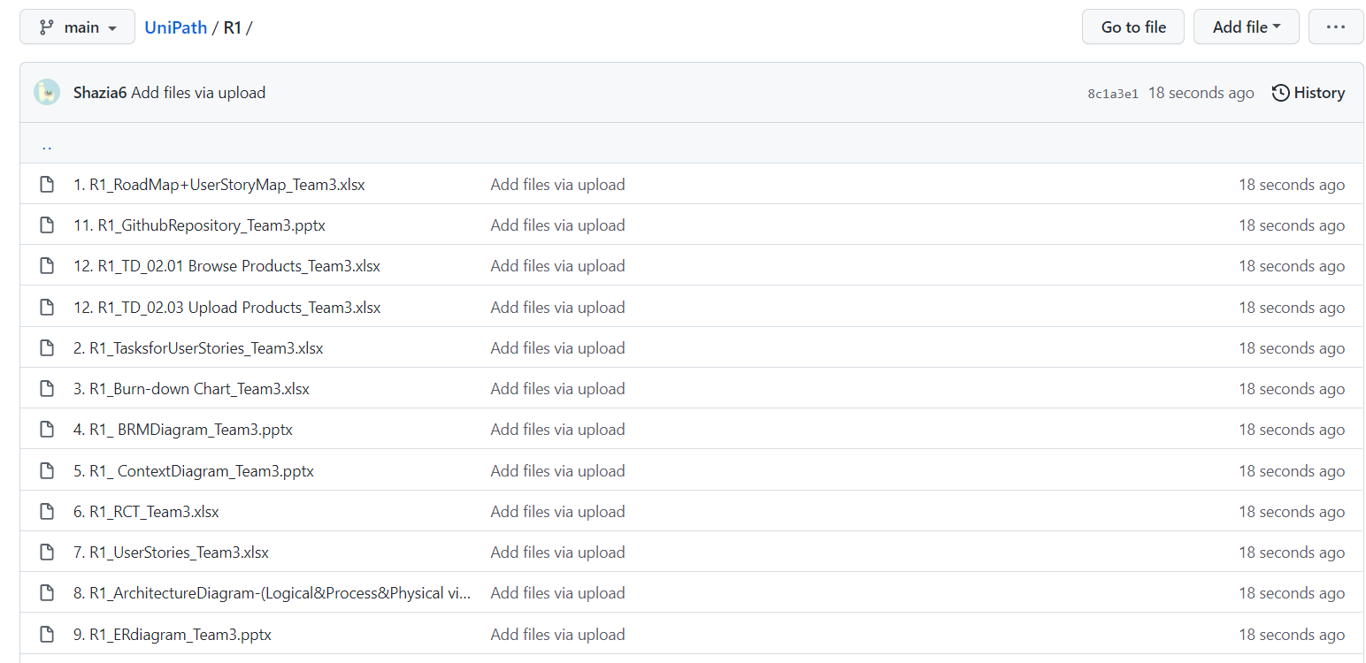
R1 Folder:

Slide 7
R2 folder:

Slide 8
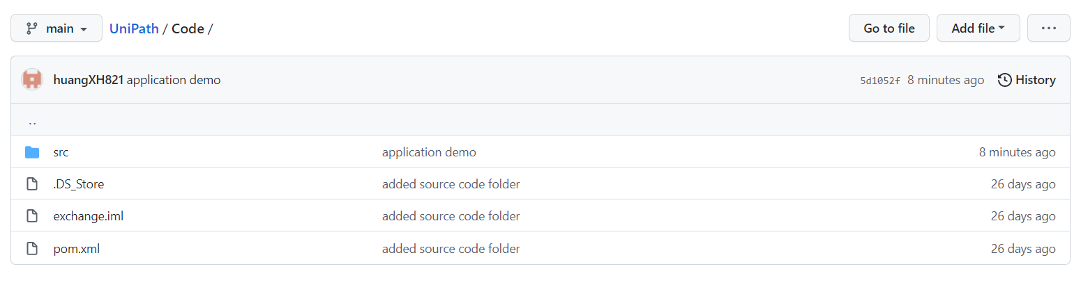
Source-Code folder:

Slide 9
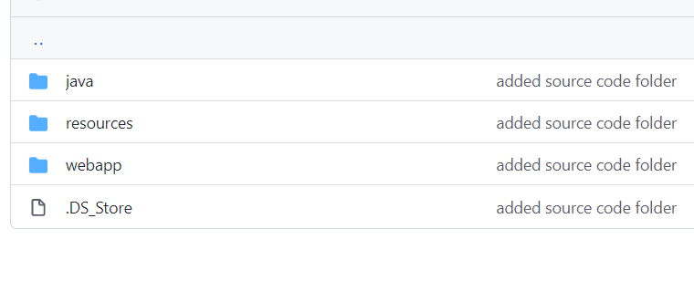
Folders:

Slide 10
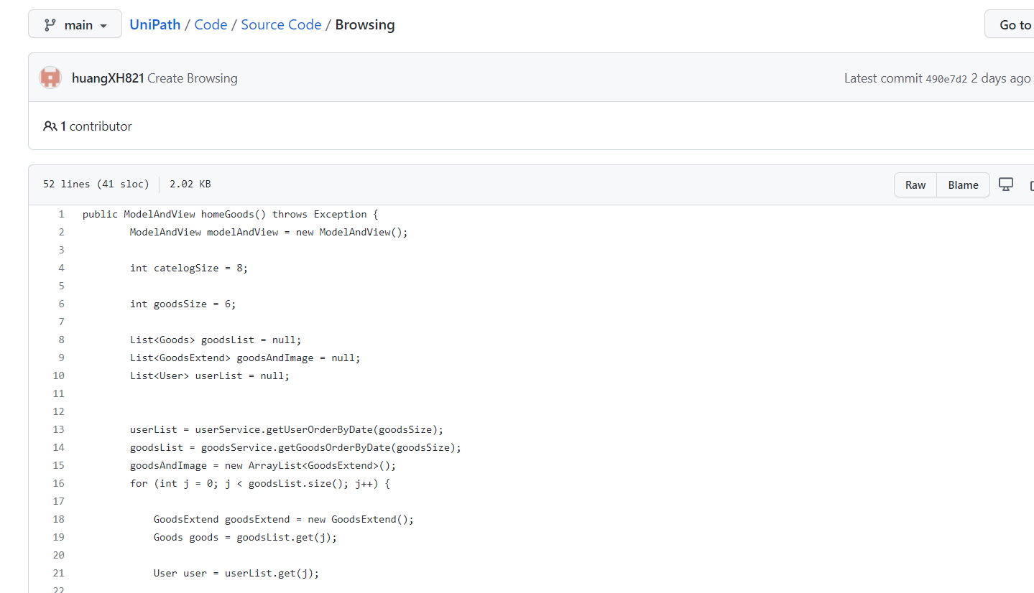
Code:

Slide 11
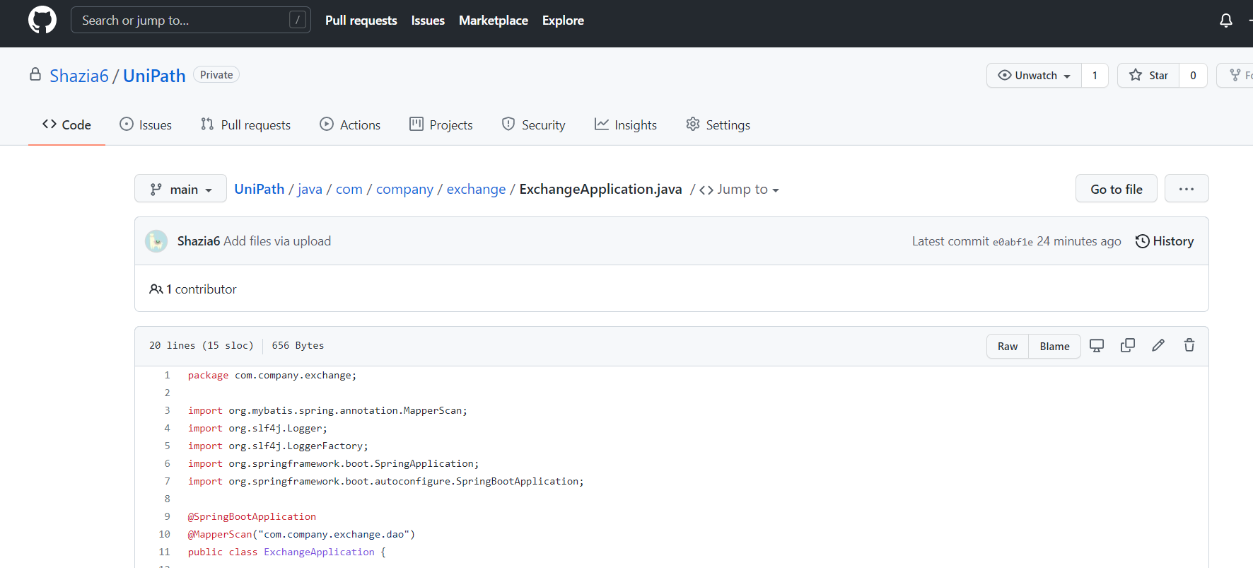
Code:

Slide 12
